Slide 1

me
TRAFFIC SIGN RECOGNITION
BY
S.Yuvan Velkumar

Slide 2

ABSTRACT
Classifying traffic signs is an indispensable task for autonomous driving systems.
Depending on the country, traffic signs possess a wide variability in their visual appearance making it harder for classification systems to succeed.
Either the classifier should be fine-tuned or a bigger collection of images should be used.
Nowadays, Intelligent Autonomous Vehicles together with Advanced Driver Assistance Systems (ADAS) deal with the problem of traffic sign recognition.
It is a challenging real world computer vision problem due to the different and complex scenarios they are placed into.

Slide 3
PROJECT OVERVIEW
All Through this project we aim to make a system which can be used universally for traffic signs and symbols, which in turn would help us learn more about deep learning.
The objectives of the system is first to detect and then classify signs. To detect, a combination of MSER and HSV is used. This works well when we have lots of images as well as not clear ones.

Slide 4
INTRODUCTION
Traffic sign detection and recognition (TSDR) system has been introduced to reduce traffic safety concerns.
A TSDR system detects and recognizes traffic signs from and within images captured by cameras or imaging sensors displaying to the user the user what traffic rules are applicable at that stretch of road.

Slide 5
WHO ARE THE END USERS?
The end users of this traffic sign recognition system would be common people who are using vehicles.
This reduces the majority of accidents.

Slide 6
REQUIREMENTS
SOFTWARE REQUIREMENTS
Python(version above 3.0)
OpenCV
Imutils
Numpy
HARDWARE REQUIREMENTS
PC with webcam or external camera

Slide 7
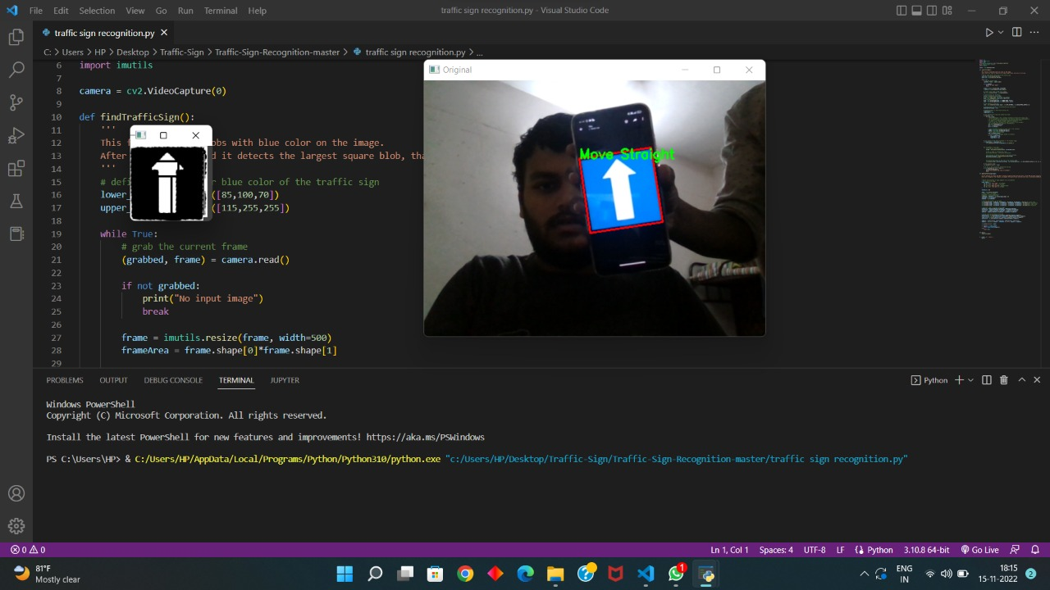
IMPLEMENTATION

Slide 8


Slide 9
THE WOW IN YOUR SOLUTION
The wow part of this implementation this can recognize any traffic sign of any country. But we have to feed the dataset for this, the dataset for this can be found easily.
When driving on congested roads, it’s sometimes difficult to keep your eyes everywhere at once. Checking the road ahead, oncoming traffic, what’s behind you, all while trying to maintain your speed can sometimes become quite distracting.
With the introduction of Traffic Sign Recognition systems, the chances of not noticing a change in speed limit, or the warning of a potential hazard ahead have been vastly reduced.

Slide 10
RESULTS
The program is able to detect traffic signs and display them.

Slide 11

MEET OUR TEAM
.
.

